Slide 1

SOIL QUALITY PREDICTION
Varsha V Nair

Slide 2

INTRODUCTION:
The project focuses on predicting soil quality using machine learning.
It aims to provide accurate soil classification based on soil and environmental data.
Helps farmers make better decisions for crop selection and resource management.

Slide 3

FEATURES:
Pollutant Concentration
Temperature
Humidity
Soil pH_Value
Rainfall
Soil Organic Matter

Slide 4
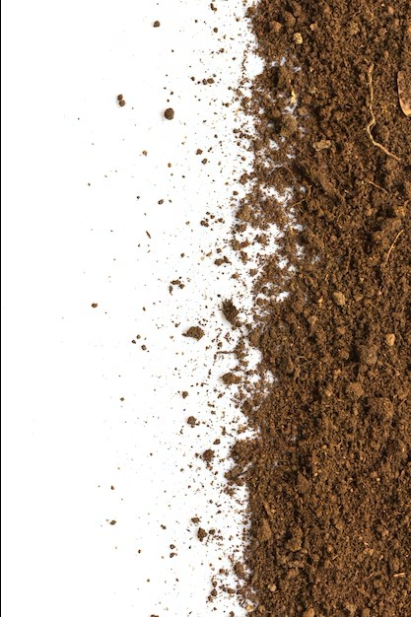
TARGET VALUE
Soil Quality:
The target variable “Soil Quality” was selected because the primary objective of this project is to recommend the most suitable soil under environmental conditions, making it the key output for driving data-driven agricultural decisions.

Slide 5
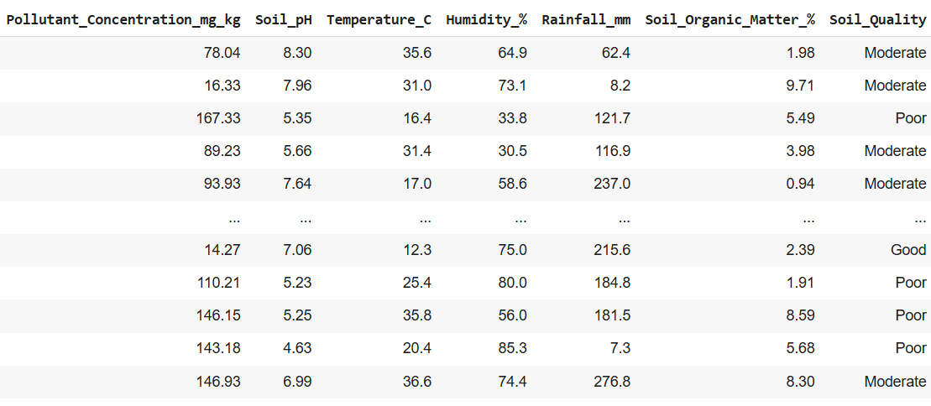
DATASET

Slide 6

MODELS:
LOGISTIC REGRESSION
DECISION TREE CLASSIFIER
RANDOM FOREST CLASSIFIER
ADABOOST CLASSIFIER
GRADIENTBOOST CLASSIFIER
KNEIGHBOURS CLASSIFIER
GAUSSIAN NB CLASSIFIER

Slide 7
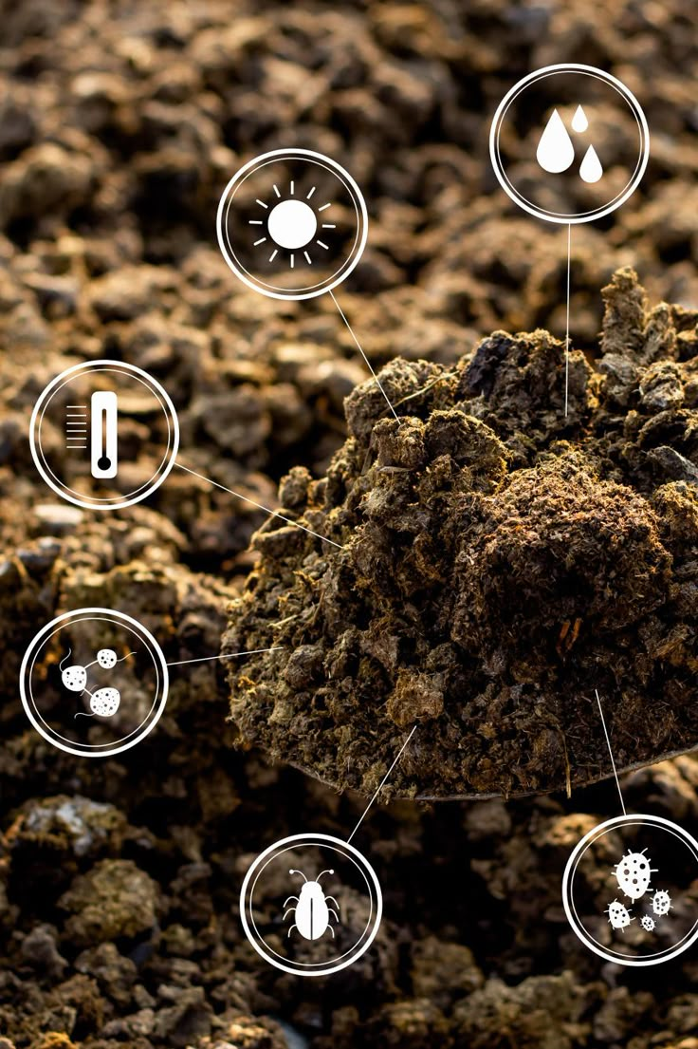
APPLICATIONS:
Optimizing Crop Selection: Predicting soil quality helps farmers choose the most suitable crops for their land, which is critical for maximizing yields and ensuring profitable harvests.
Efficient Fertilizer Management: By analyzing nutrient levels, this application allows for precise recommendations on the type and number of fertilizers to use, reducing waste, saving costs, and minimizing environmental runoff.
Environmental Monitoring: Soil analysis is essential for detecting and predicting the presence of pollutants and heavy metals, making it a key tool for environmental conservation and the remediation of contaminated land.
Enhancing Precision Agriculture: The ability to create detailed soil maps based on predicted quality enables farmers to apply resources like water and nutrients in a targeted manner, leading to more efficient resource use and improved productivity.
Land-Use and Construction Planning: In civil engineering, predicting soil properties is vital for assessing land stability and suitability for construction projects, ensuring the safety and longevity of infrastructure like buildings and roads.

Slide 8

CONCLUSION:
The project uses machine learning for targeted soil quality prediction.
It classifies soil as 'Good,' 'Moderate,' or 'Poor' using environmental and soil data.
DecisionTreeClassifier and RandomForestClassifier achieved 100% testing accuracy.
Helps farmers make better crop decisions and optimize yield.
Promotes sustainable agriculture benefiting the economy and the environment.

Slide 9
THANK YOU.

